Slide 1
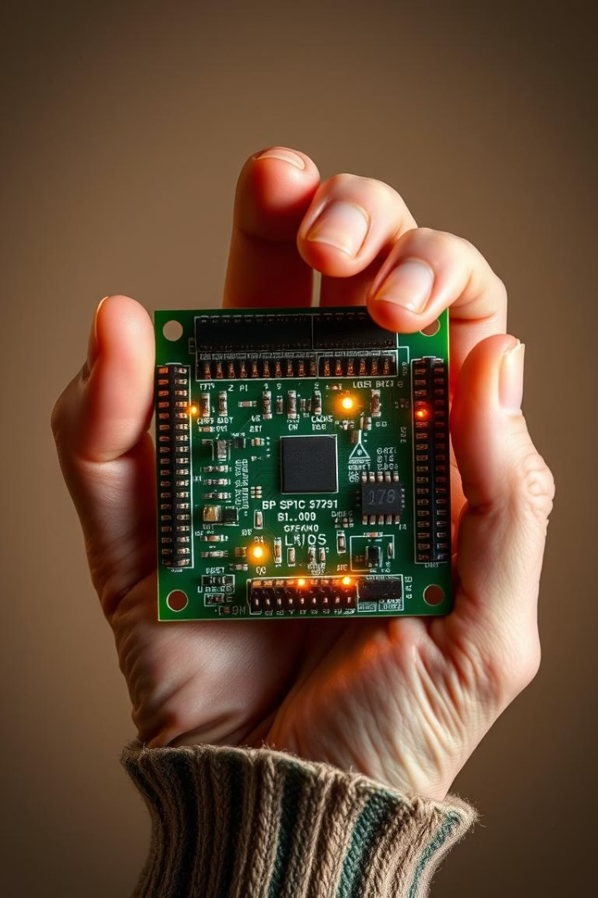

SPI Communication Protocol
Presented by K. Sree Badrinath, Ch. Pranai and T. Obul Sai.
Notes:
1

Slide 2
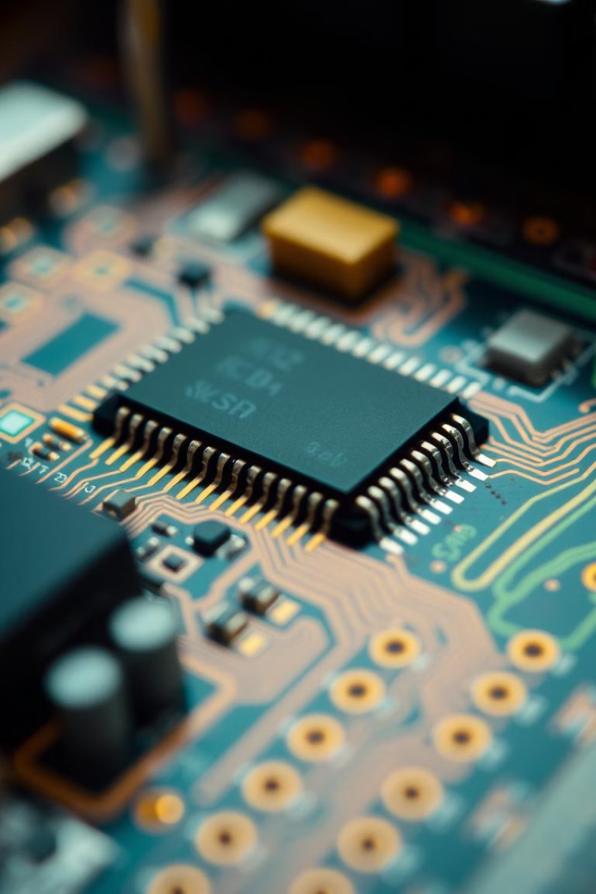
Introduction to SPI Communication
SPI (Serial Peripheral Interface) is a synchronous serial communication protocol. It's ideal for simple, short-distance communication. SPI is widely used in embedded systems for device interfacing.
Notes:
2

Slide 3
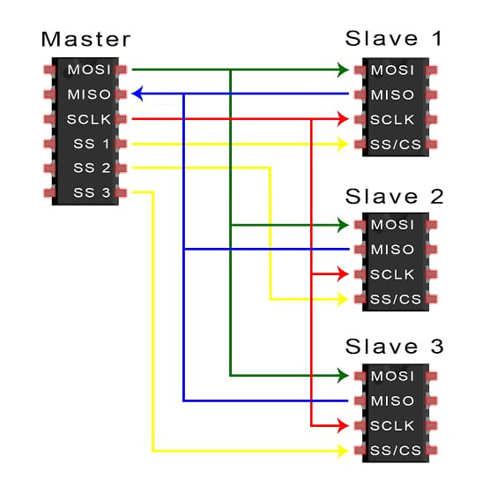

Slide 4
SPI Basics: How it Works
Architecture
Data Transmission
Why Use SPI?
Single master controls one or more slaves in SPI communication.
Master initiates transmission and controls the clock.
Provides high-speed communication for short-distance connections.
MOSI - Master Out Slave In
Supports full-duplex data exchange simultaneously.
Simple hardware design with low pin count.
MISO - Master In Slave Out
SCK - Serial Clock
Allows multiple devices to be connected and controlled from a single master.
SS/CS - Slave Select or Chip Select
Notes:
3

Slide 5
Advantages and Disadvantages of SPI
Advantages
Disadvantages
Simple to Implement: Protocol requires minimal hardware and coding effort.
Requires More Pins: Needs separate lines for each slave select, increasing wiring complexity.
High Speed: Supports data rates over 100 Mbps for fast communication.
No Standardized Protocol: Lacks standardized message format, which may cause interoperability issues.
Full-Duplex: Transmits and receives data simultaneously for efficiency.
Short Distance Only: Best suited for short-distance communication; not suitable for long cables.
Flexible Format: Supports variable data lengths for diverse uses.
No Acknowledgment: No built-in error checking or acknowledgment mechanism.
Low Power: Efficient operation suits battery-powered gadgets.
Limited Bus Length: Signal degradation limits the bus length and number of devices.
Notes:
4

Slide 6
SPI Modes
SPI communication operates in four modes defined by clock polarity and phase.
Mode selection ensures correct data sampling and timing between master and slave.
Clock Polarity (CPOL)
Clock Phase (CPHA)
Modes Summary
Defines the idle state of the clock signal (high or low).
Determines which clock edge data is sampled on—leading or trailing.
Mode 0: CPOL=0, CPHA=0
Mode 1: CPOL=0, CPHA=1
Mode 2: CPOL=1, CPHA=0
Mode 3: CPOL=1, CPHA=1
Notes:
5

Slide 7
SPI Modes
Parameters
Four Modes
CPOL: Clock Polarity
Mode 0: CPOL=0, CPHA=0
CPHA: Clock Phase
Mode 1: CPOL=0, CPHA=1
Modes define clock idle state and data sampling edge.
Mode 2: CPOL=1, CPHA=0
Mode 3: CPOL=1, CPHA=1
Master and slave must use the same mode for communication.
Notes:
6

Slide 8
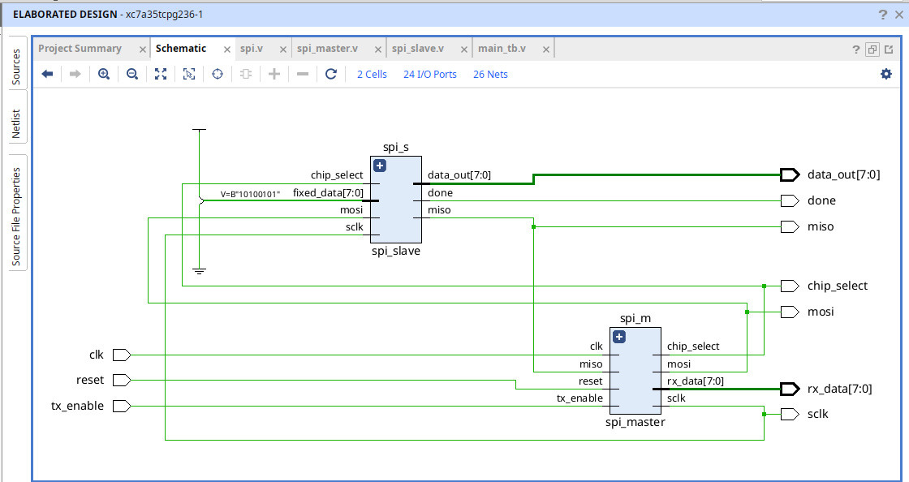

Slide 9
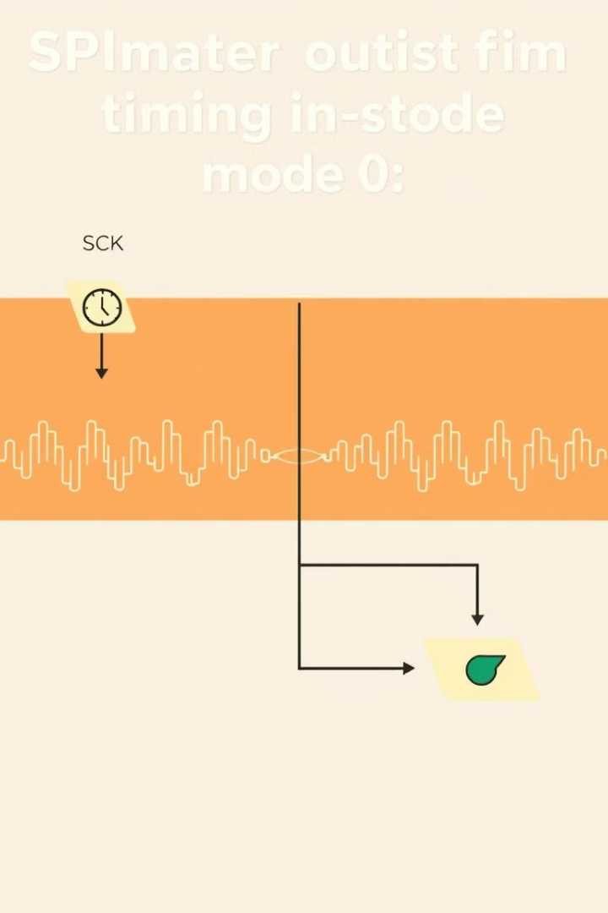
SPI Signal Timing Diagram
Key Signals
Setup and Hold
SCK clock controls data synchronization.
Data must be stable before and after clock edge.
Mode 0 Example
Data sampled on rising edge with clock idle low.
Notes:
7

Slide 10
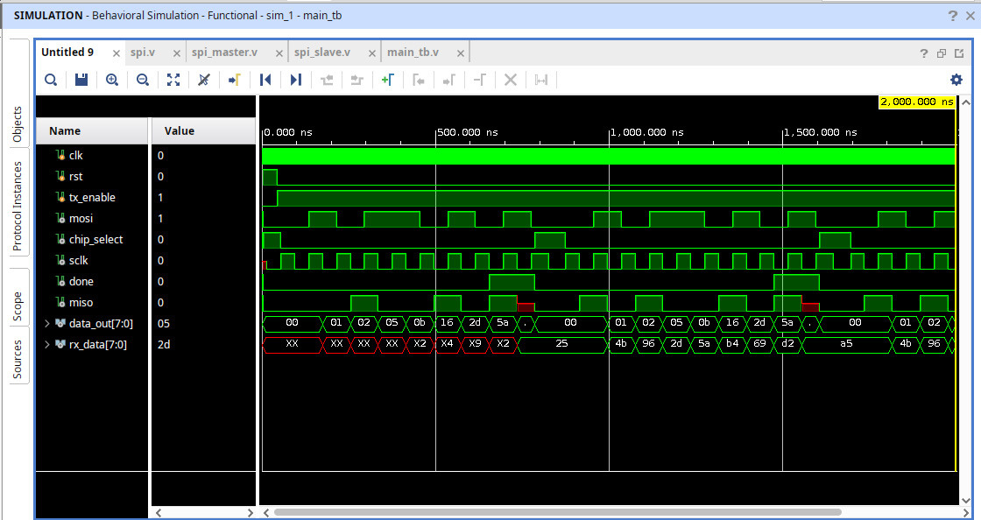

Slide 11
Common Applications of SPI
Peripheral Devices
Additional Uses
Temperature, pressure, accelerometer sensors
LCD and display interfaces
EEPROM and Flash Memory
ADC and DAC converters
Real-time clocks (RTC)
Inter-processor embedded communication
SD card data transfer
Notes:
8

Slide 12
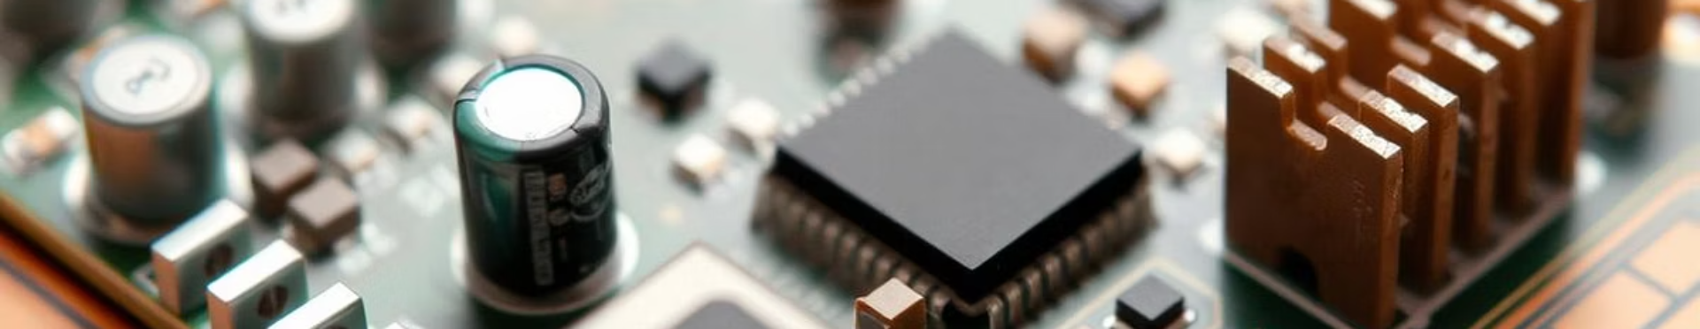
Conclusion
Versatile and Widely Used
Simple and Fast
SPI fits many embedded communication needs.
Easy to implement with high data speed.
Understand Limitations
Choose Correct Mode
Account for short range and lack of error checks.
Matching clock settings ensures proper operation.
Notes:
9

Slide 13

Thank You
We appreciate your attention to SPI communication protocol.
Notes:
10

